Slide 1
Chapter 2
PROGRAMMING CONCEPTS-1

Slide 2
ASSEMBLY LANGUAGE PROGRAMMING
To code efficiently in assembly language for a particular processor ,the prerequisites are
a good knowledge of the internal architecture of the processor and addressing modes

Slide 3
The Assembly Process
An assembler is a translator that translates source instructions( in symbolic language)
into target instructions (in machine language)
on a one to one basis.

Slide 4
Features of assemblers
Labels are used for memory addresses
Labels are used for constants
Macros are allowed

Slide 5
Instructions and Directives
Instructions are executable statements
Directives are non-executable .
Directives are also called pseudo instructions.
Directives aid the assembly process.

Slide 6
What the assembler does
It takes the source code (in assembly language) and converts it to the object code in machine language

Slide 7
The Forward Reference Problem
In assemblers ,when a label which has not yet been defined ,is encountered,
it is called the forward reference problem or
future symbol problem or
the problem of unresolved references .

Slide 8
Passes of an assembler
In the first reading or ‘pass’ of the assembler , it looks for label definitions and inserts them in the symbol table after assigning them addresses .
In pass 2 , the actual translation of assembly code to machine code is done .

Slide 9
ASSEMBLERS FOR x86
NASM ,FASM ,MASM ,TASM and HLA
FASM and NASM –can run under DOS, Linux and Windows
TASM and MASM are very popular
It is found now that Windows 7 ,8 etc do not directly support DOS based 16 bit programs – so 16 bit assemblers may not work with Windows 7 directly.

Slide 10
Why MASM ?
Microsoft has written considerable documentation
Third parties have written assembly language reference manuals for MASM.
The versions of MASM 6.0 and above have a lot more features (aimed at simplification in writing code )than previous versions .
Working Principle ?

Slide 11
Memory Models
To write programs, we have to define segments where segment registers must be initialized
Will take to use the full segment model
MASM 6.0 and above have incorporated certain shortcuts to make programme simple
They are called Dot Models.
To specify a segment ,write
. MODEL MODEL NAME
Different models tell the assemble how to use segements and to provide sufficient space for the object code.
simplest way is tiny model and small model

Slide 12
Tiny model is used when code, data and stack will all fit into one segment with maximum of 64 K
Small model can have one data segment and one code segment each of which has a maximum size of 64 K
TINY Model
Program
.MODEL TINY ;choose single segment model
.CODE ; start of code segment
.STARTUP ; start of program
MOV AL,67H ; move 67H to AL
MOV BL,45H ; move 45H to BL
ADD AL,BL ; add BL to DL
MOV DL,AL ; copy AL to DL
.EXIT ; exit to DOS
END ; program end

Slide 13
Save it a as tiny.asm
Open MASM and go to the BIN directory.Use the following commands
ml tinym.asm ;for assembling and linking
ml/Fl tinym.asm ;for the list file

Slide 14
The result of assembling and linking ( DOS command window)
C:\masm6.14\BIN>ml tinym.asm
Microsoft (R) Macro Assembler Version 6.14.8444
Copyright (C) Microsoft Corp 1981-1997. All rights reserved.
Assembling: tinym.asm
Microsoft (R) Segmented Executable Linker Version 5.60.339 Dec 5 1994
Copyright (C) Microsoft Corp 1984-1993. All rights reserved.
Object Modules [.obj]: tinym.obj /t
Run File [tinym.com]: "tinym.com"
List File [nul.map]: NUL
Libraries [.lib]:
Definitions File [nul.def]:

Slide 15
Example showing list file
.MODEL TINY ; choose single segment model
0000 .CODE ; start of code segment
.STARTUP ; start of program
0100 B0 67 MOV AL,67H ; move 67H to AL
0102 B3 45 MOV BL,45H ; move 45H to BL
0104 02 C3 ADD AL,BL ; Add BL to AL
0106 8A D0 MOV DL,AL ; copy AL to DL
.EXIT ; Exit to DOS
END ; assembler to stop reading
On the left hand side, we see the offsets within the code segments in which the code is saved.
offsets are generated by assemblers
We also see opcodes corresponding to each instruction
example (1st Instruction), 0100H is the offset in the code segment where the first instruction is stored
BO 67 is the opcode of MOV AL, BH

Slide 16
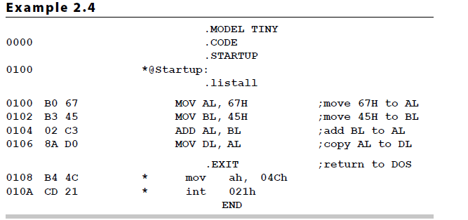
if we add directive.listall, the list file is changed as shown below,

Slide 17
.Listall has listed the instructions corresponding to .EXIT
.EXIT is a shortcut, which is actually transformed to two instructions:
MOV AH,4CH
INT 21H

Slide 18
Using the debugger
To enter the debugger ,type debug tinym.com .
We get an underscore as the prompt.
On typing ‘r’, we can see the contents of the registers ,before execution of the program .
Now type ‘u’, which is the command for unassembling. (i.e Logical address of the first instruction)

Slide 19
C:\masm6.14\BIN>debug tinym.com
-r
AX=0000 BX=0000 CX=010C DX=0000 SP=0000 BP=0000 SI=0000 DI=0000
DS=13AD ES=13AD SS=13BD CS=13BD IP=0100 NV UP EI PL NZ NA PO NC
13BD:0100 B067 MOV AL,67
-u
13BD:0100 B067 MOV AL,67
13BD:0102 B345 MOV BL,45
13BD:0104 02C3 ADD AL,BL
13BD:0106 8AD0 MOV DL,AL
13BD:0108 B44C MOV AH,4C
13BD:010A CD21 INT 21

Slide 20
COM and EXE files
com files have only one segment (CS)
run file generated by the tiny model is a command (.com) file, rather than an executable (.exe) file
shown in example 2.2 ; Run File [tiny.com]: “tinym.com”
later seen that run files will be obtained as ‘executable’ with .exe
A tiny model generates only a com file ,
while any other memory model generates an exe file

Slide 21
Features of a com file
Size is limited to 64K
Only one segment ,which is the code segment
Data is defined in this code segment
Code starts at offset 0100 H ,just after the PSP (program prefix segment ) of DOS
Smaller file compared to exe files ,because it does not have the 512 byte header block

Slide 22
previous examples have seen the tactics of running and analysing a single segment assembly language program running in MASM
We see now, the listing corresponding to another program which uses tiny model

Slide 23
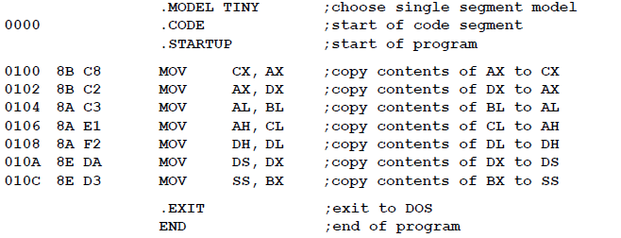
Above Eg, shows a sequence of instructions that copy various data between 16 and 8-bit registers
The act of moving data from one register to another changes only the destination register, never the source.

Slide 24
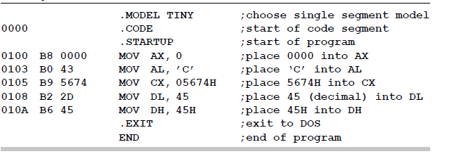
Listing and it shows various assembly language instructions that use immediate addressing
only 8-bit can be placed into 8-bit register
16 bit copied to 16 bit registers
look at 2nd instruction

Slide 25
MOV AL, C
here assembler translates ASCII ‘C’ to its hex equivalent 43H
all data written in memory will be in hex format
Thus, the decimal 45 is found to 2DH in the listing
A data (byte, word) starting with the hex character A,B,C,D,E,F must be preceded by a 0.
else it gives error
i.e MOV AL, EFH gives assembly error
shud be rewritten as MOV AL, 0EFH
Similarly MOV BX, C456H as MOV BX, 0C456H

Slide 26
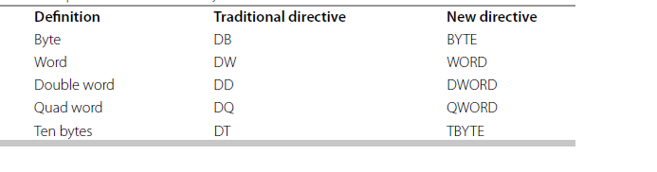
Definition of Data Types
Before we go to two-segment model
need to understand a few directives of the assembler, that describes different kinds of data
May be Bytes, Words etc..
We have to define data and assign labels to their corresponding addresses
Defining data implies allocating space for data
Data is accordingly using directives
some of the Data Definitions used in MASM are:

Slide 27
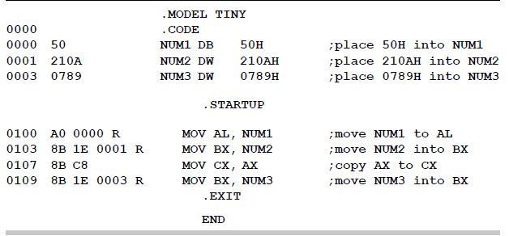
Eg shows data being placed in code segment itself
In tiny model, we can have data and code in the same segment, with the instruction that the size of the segemnt should not exceed 64Kbytes
NUM1, NUM2 and NUM3 are locations which store data
NUM1 is a byte location, while NUM2 and NUM3 are word locations

Slide 28
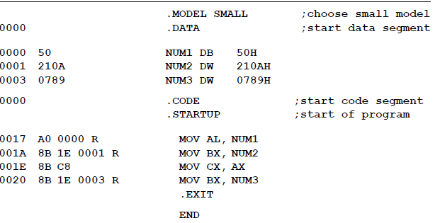
The small model
Here two segments are used –
A code segment and a data segment

Slide 29
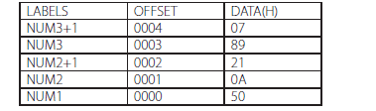
Data segment with labels and off sets corresponding

Slide 30
DUP Directive
is used to replicate a given number of characters.
Eg, we need to fill up a number of locations in the data segment with the same word or byte
NUMS DB 10 DUP(0) fills up with 0s the 10 byte locations starting with the label NUM
STARS DB 5 DUP(‘#’) fills up 5-byte locations starting at location STARS, with the ASCII value of the character #
BLANK DB 10 DUP(?) reserves 10-byte spaces starting from location with the label BLANK, but these are not initialized, means whatever data is there will remain same
WRDS DW 4 DUP(FF0FH) fills up 4 word locations with the word FF0FH

Slide 31
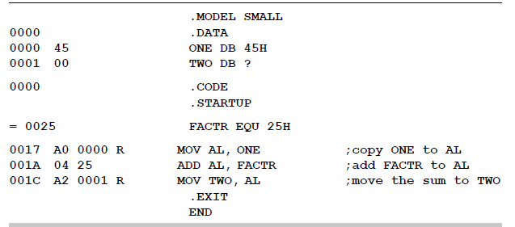
EQU Directive
Used to equate names to constants
The assembler just replaces the names by the values mentioned
Eg: TEMP EQU 34
PRICE EQU 199

Slide 32
ORG Directive
ORG is a directive which means ‘origin’.
In the context of assembly language programming, it can change the location of storage of data or code in memory
i.e programmer gets the freedom to decide the offset of data or code when it is stored.

Slide 33
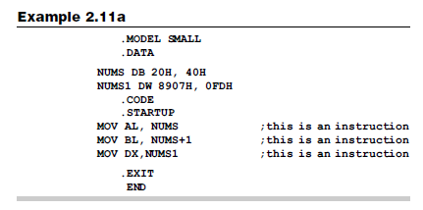
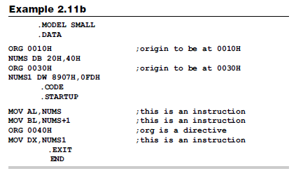

Slide 34
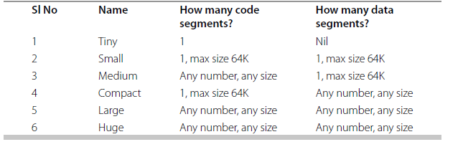
Other Models

Slide 35
Full Segment Definition
Is a traditional model of MASM
In the simplified memory model, it is left to the loader software to initialize the segment registers
In traditional model we use directives to define segments and instructions to initialize the segment registers
This is called full segment definition
CS & SS registers are automatically initialized by the loader
DS & ES will have to be initialized by the programmer

Slide 36
Lets rewrite the below program using full segment definition

Slide 37
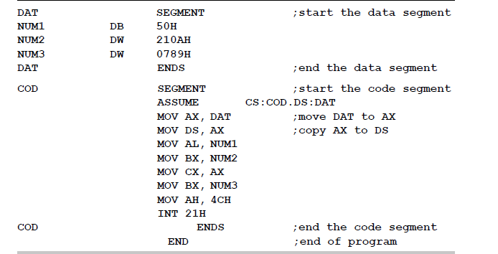

Slide 38
Salient features of this model
the data segment has been given the name DAT. The data within the segment is enclosed between the SEGMENT and ENDS directives which are similar to the parentheses for a segment
similarly CS is named as COD and the contents of this segment also have been enclosed between the same directives
DS register has been initialized by the first two instructions. DS cannot use immediate addressing. So DAT corresponds to a number, has to be loaded to AX, then transfer to DS
The value of DAT is loaded into DS.
CS register needs not to be initialized in the program. This is done by the loader by default.

Slide 39
Instruction Design
We have discussed about assemblers and how to run those programs
Now lets study the core of the processor and investigate the process of how machine codes have been designed.
Manual Coding is a idea of thinking the possibility of doing manual or hand coding, as it is called taking an assembly instructions, looking up or finding out its machine code, and feeding directly to the processor.
It was happening during 8085 processor as it has limited instruction sets and look up table was sufficient for hand coding.
Instruction Set Architecture (ISA) gives almost appropriate definition, defined as the part of computer architecture related to programming, including the native data types, instructions, registers, addressing modes, memory Arch., interrupt and exception handling, and external I/O. It includes a specification of the set of opcodes (machine language), i.e., the native commands implemented by a particular CPU design.

Slide 40
Instruction Set Design of 8086
8086 has instruction size varies from one byte to five bytes
This makes the processes of assembly, disassembly and instruction decoding complicated because the instruction length needs to be calculated for each instruction.
An instruction should have the complete information for fetching and executing an instruction.
It should have the following information
1. Opcode corresponding to the operation carried out
2. Size of the Operands
3. Various addressing modes

Slide 41
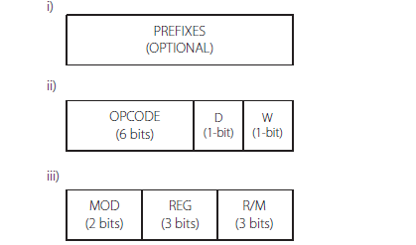
Format of three bytes of an instruction

Slide 42

Prefix:
This is an optional byte and need to be used only to change the operation, e.g. segment override prefix

Slide 43

First Byte
Considered as the first byte of an instruction
Here the operation code (opcode) which is 6 bytes long.
This is the code which defines the operation to be carried out. The two other bits are D & W
W (1-bit) – operand size. W = 1, word operand; W = 0, means byte operand.
D (1-bit) – Direction bit. D = 1, register is destination; D = 0, register is source

Slide 44

Second Byte
MOD (2-bit) – Register bits. REG (3-bit) – the identifying code of the register used. R/M (3 bits) – Specifying a register or memory operand. The MOD and R/M bits together specify the addressing mode of the instruction.
All the instructions need not have the D & W bits. In such cases, the size of the operand is implicit, and the direction is irrelevant.

Slide 45
Designing a Code
Requires a lot of information such as codes or registers a table showing the MOD and R/M bits corresponding to various combinations of addressing modes
Intel manual for the opcodes and formats of instructions.

Slide 46
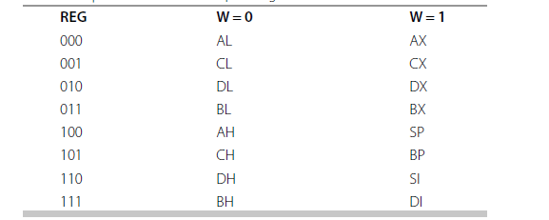
Codes of General-Purpose Registers

Slide 47
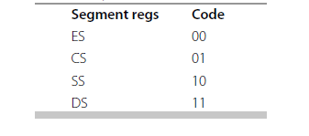
Codes of Segment Registers

Slide 48
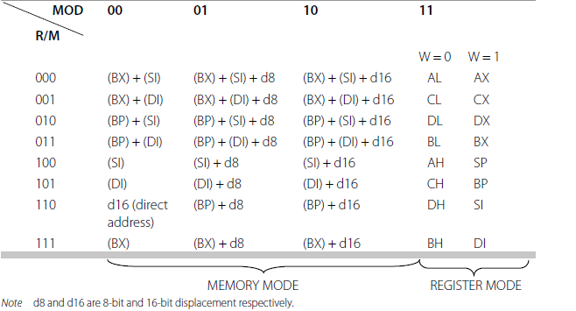
Codes Pertaining to Addressing Modes – MOD and R/M Bit Patterns

